Slide 1




LESSENING CARBON FOOTPRINT
TEAM PHOENIXICIA

Slide 2





SITUATION ANALYSIS
1 KILOGRAM OF PLASTIC RESULTS IN
3 KILOGRAMS OF CARBON DIOXIDE GAS
FOOD WASTE HAS A CARBON FOOTPRINT OF ABOUT
3.3 BILLION TONS OF CO2

Slide 3
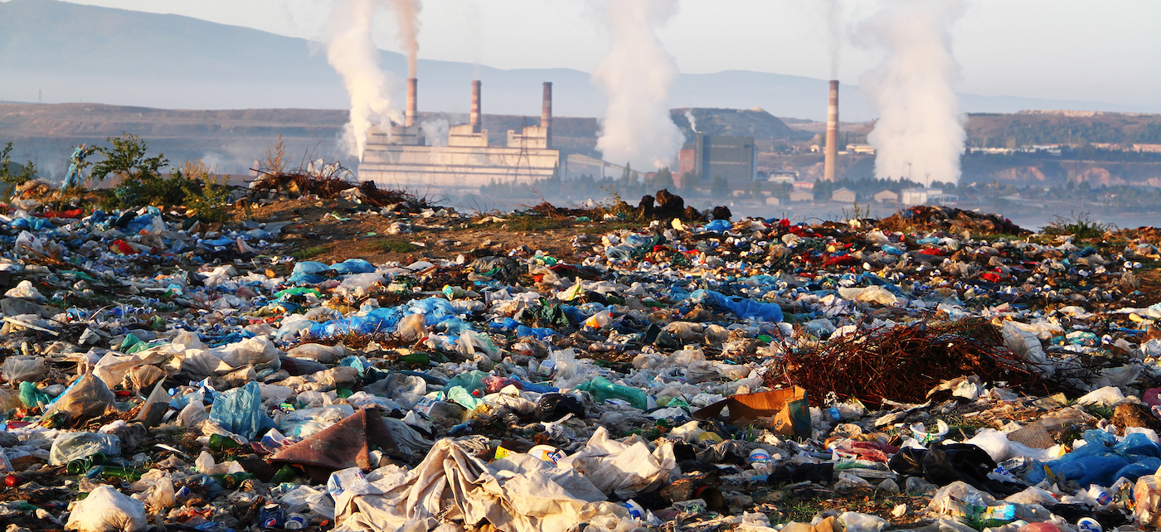







CONVENTIONAL MIXED WASTE COLLECTION LEADING TOWARDS LANDFILL
37% COLLECTION RATE; BUT WASTE GROWTH RATE 21.39%
8,52,390 TONS OF WASTE IS PRODUCED EVERY YEAR IN DHAKA
BANGLADESH IS ONE OF THE MOST POLLUTED COUNTRIES
AMINBAZAR & MATUAIL LANDFILL ALREADY GOT FUFILLED
INHABITANTS ARE
UNAWARE OF UPCOMING WASTE DISASTER

Slide 4



CORE PROBLEM
LACK OF SUITABLE PLATFORM FOR
ENVIRONMENT CONCERNED & IMPACT ORIENTED WASTE TREATMENT WITH CUSTOMIZATION
LACK OF TECHNOLOGY BASED SERVICE
WITHOUT PLANNING WASTE COLLECTION
NO DATA TRACTION
ZERO IMPACT

Slide 5
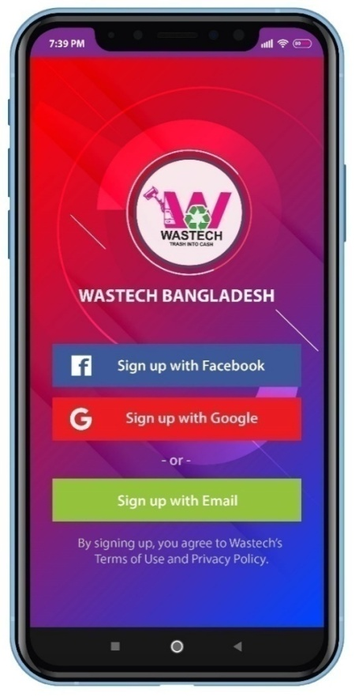
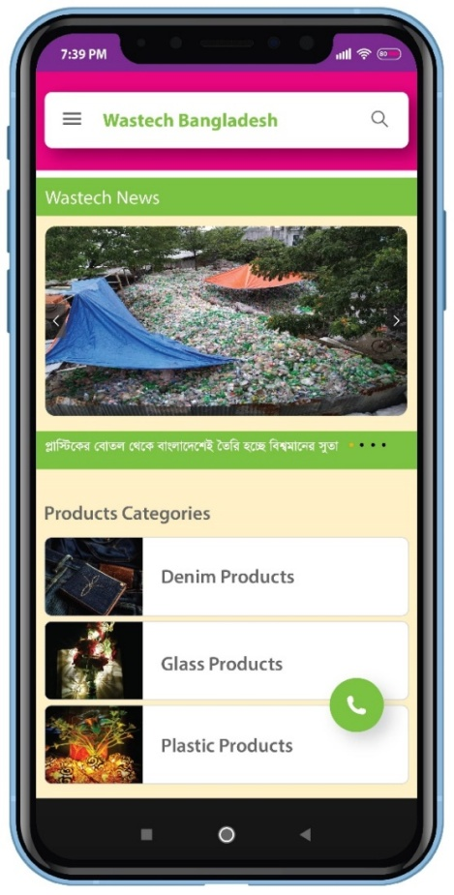
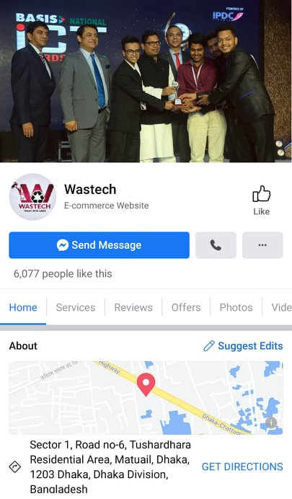
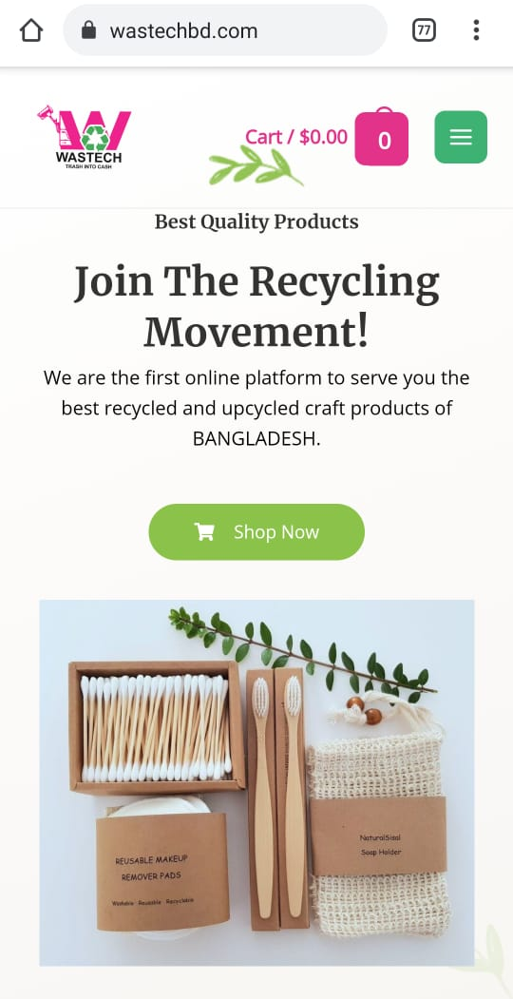




WASTECH
TRASH INTO CASH
ONE STOP SOLUTION FOR DEMAND WISE WASTE COLLECTION & CUSTOMIZATION OF SEGREGATED WASTE INTO UPCYCLED & RECYLABLE MERCHANDISE
APPS & WEBSITE FOR DATA TRACKING + PURCHASING
EXPORT QUALITY HANDMADE CRAFTS
IMPACT CERTIFICATE &
CASH INCENTIVE
24/7 CALL TO ACTION
WASTE COLLECTION

Slide 6


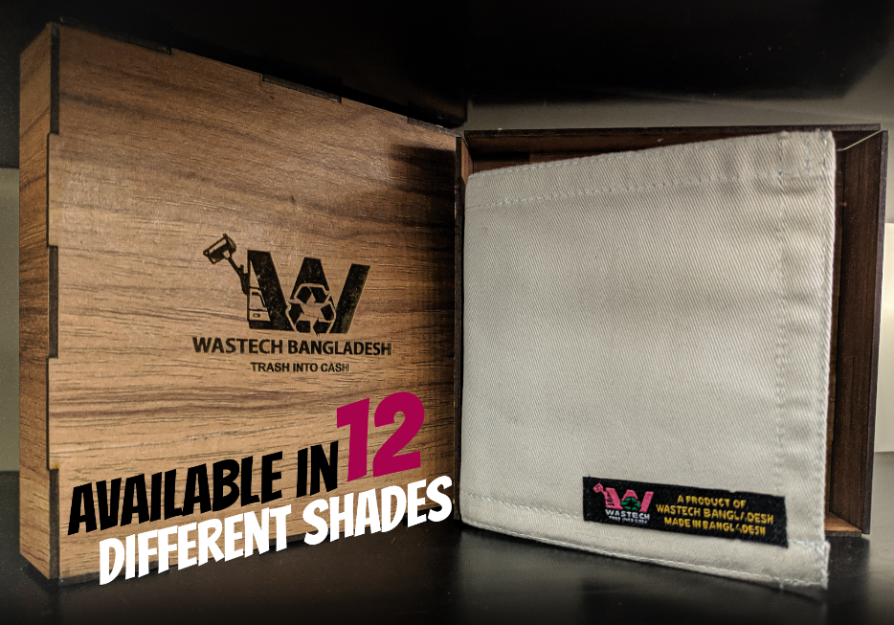

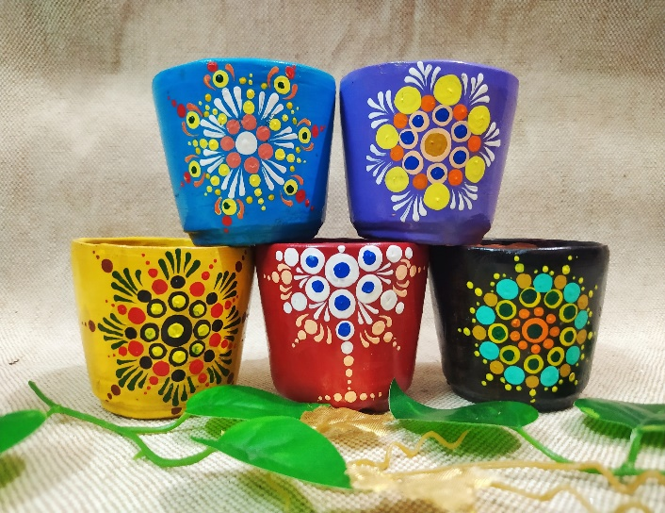


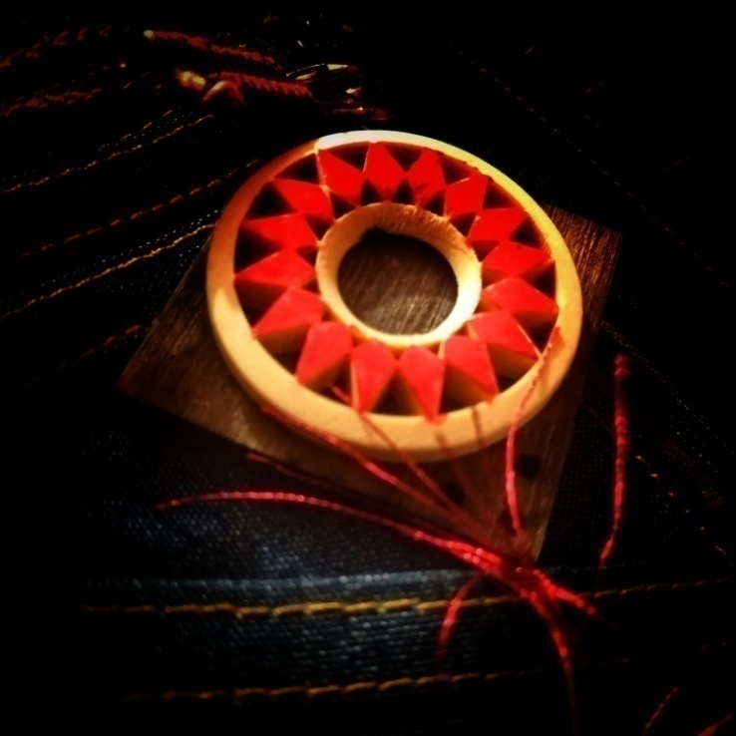
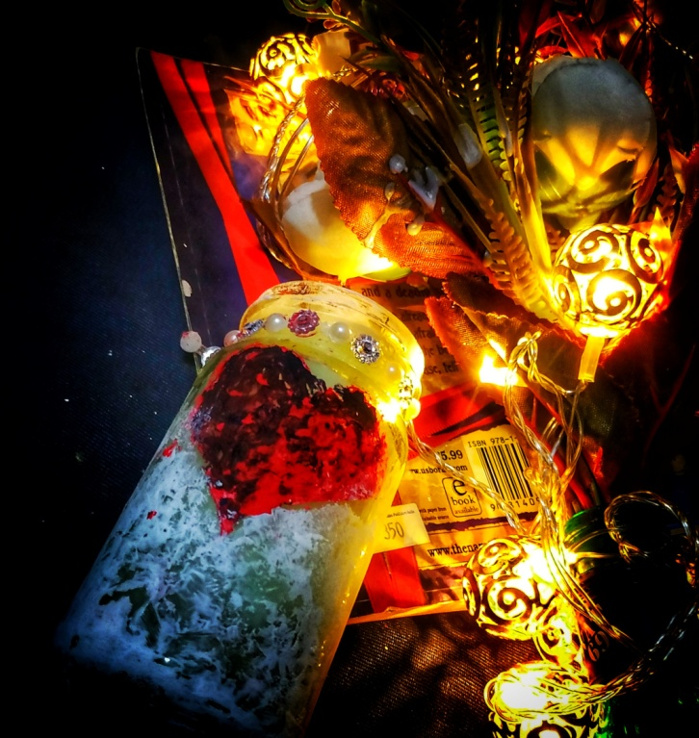
PRODUCTS
FLOWER VASE
PEN HOLDER
GLASS
CANDLE
LOCKET & WALLET
FIND MORE AT https://www.facebook.com/wastech.bd/

Slide 7
MARKET SIZE
$4.5 B
$2.83 B
$708 M
VALUE OF GENERATED WASTE
63% UNTOUCHED (BANGLADESH)
WASTECH AFFILIATED WASTE TREATMENT
(DHAKA)
TOTAL AVAILABLE MARKET
SERVICABLE ACHIEVABLE MARKET
SERVICABLE OBTAINABLE MARKET

Slide 8









TARGET MARKET
ENVIRONMENT CONCERNED ORGANIZATION/PEOPLE
B2B
B2C
WASTE COLLECTION (DHAKA)
IMPACT CERTIFICATION
WASTECH E-COMMERCE
CONSUMER SATISFACTION
INSPIRE | AFFILIATION | EDUCATION
AWARENESS | REGISTRATION | ATTRACTION
GARMENTS
RESTAURANTS
INDUSTRIES
OFFICES
CRAFT LOVERS
NATURE LOVERS
RECYCLE LOVERS

Slide 9

VISION
OUR VISION IS TO ENSURE 100% RECYCLING OF TRASH IN BANGLADESH AND TURN IT INTO A ZERO WASTE COUNTRY
MISSION
AWARENESS RATIO GROWTH
SUSTAINABLE WASTE COLLECTION CHAIN
RECYCLE STARTUP GROWTH
PROLIFERATION OF WASTE LOAD CAPACITY
FINANCIAL STABILITY OF LOWER ECONOMIC SOCIETY
OUR MISSION IS TO BRING POSITIVE PSYCHOLOGICAL CHANGE IN THE BEHAVIOUR TO WASTE AND RECYCLE THEM TO TURN THE TRASH INTO CASH

Slide 10



CORE IDEA
1
2
SEGREGATED WASTE COLLECTION FROM
TREATMENT
PROCESS
SELL IN WB PLATFORM
SOURCE [BY WASTECH TEAM]
CUSTOMIZATION
PURCHASE TO USE/GIFT
WASTECH’S DUMPING STATION
UPSELL RAW WASTE
3
4
IMPACT MEASUREMENT & AUTHORIZED CERTIFICATION
CASHBACK
INCENTIVE
PROVIDING ECO WARRIOR BADGE
10% DIRECT CASHBACK
LEGAL DOCUMENTS FROM DCC
COLLECT SIMILAR VALUED PRODUCTS

Slide 11










SUPPLY CHAIN (GO TO MARKET)
TRASH
CONNECT
COLLECTION
WORKSTATION
UPCYCLE+RECYCLE
10% CASH INCENTIVES
CASH
APPLICATION
BLOCKCHAIN
FINAL CRAFT

Slide 12
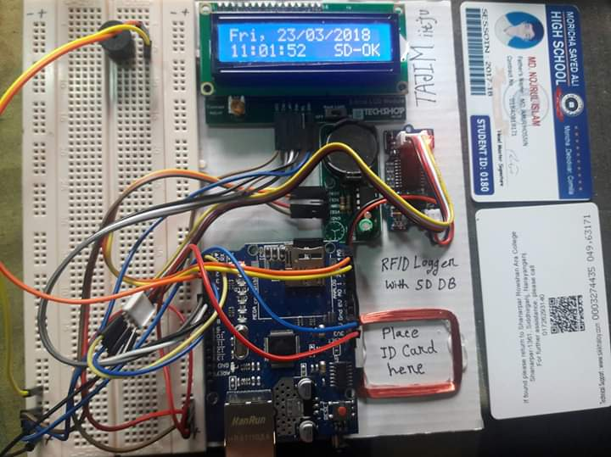
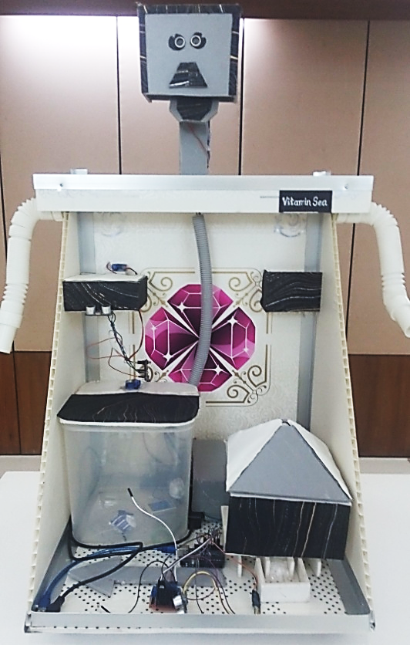
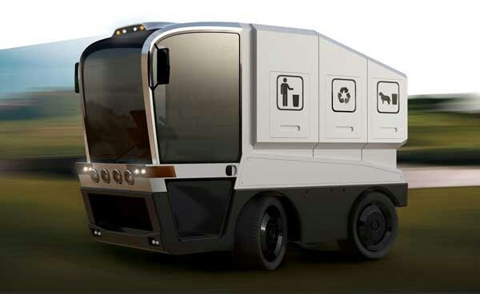
TECHNOLOGY
VACUUM & SPREADING WATER
ID MANAGEMENT SYSTEM WITH FINGER PRINT DETECTOR
ADDING NUMBER TO GARBAGE BAGS
OPENING ONE BOX AFTER ANOTHER
TOUCH SENSOR FOR MONITORING FACT
DIGITAL BILLBOARD ADVERTISING
SPEAKING ABILITY
3D VISUALIZATION
https://www.thedailystar.net/

Slide 13
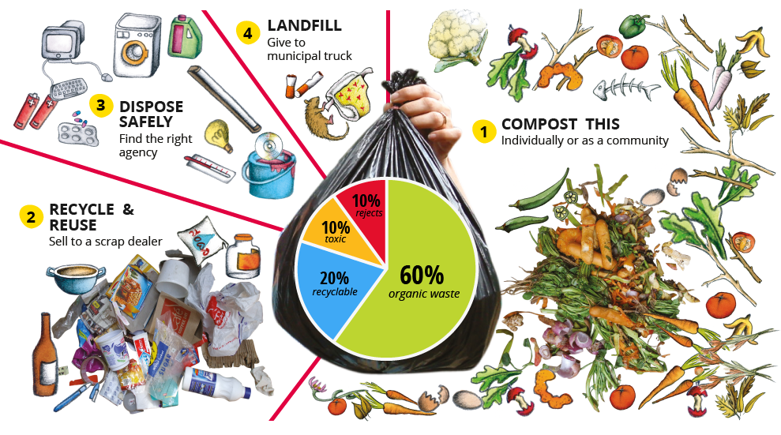
WASTE MATERIALS
ORGANIC
RECYCLABLE
TOXIC
REJECTED

Slide 14
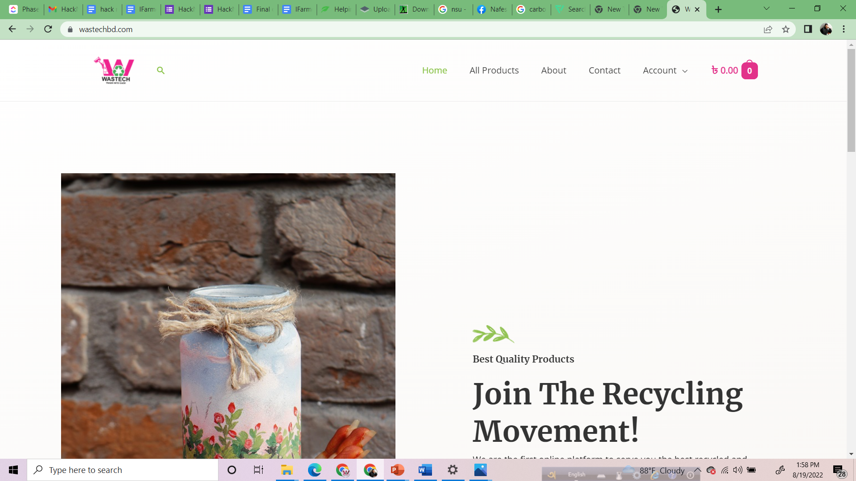
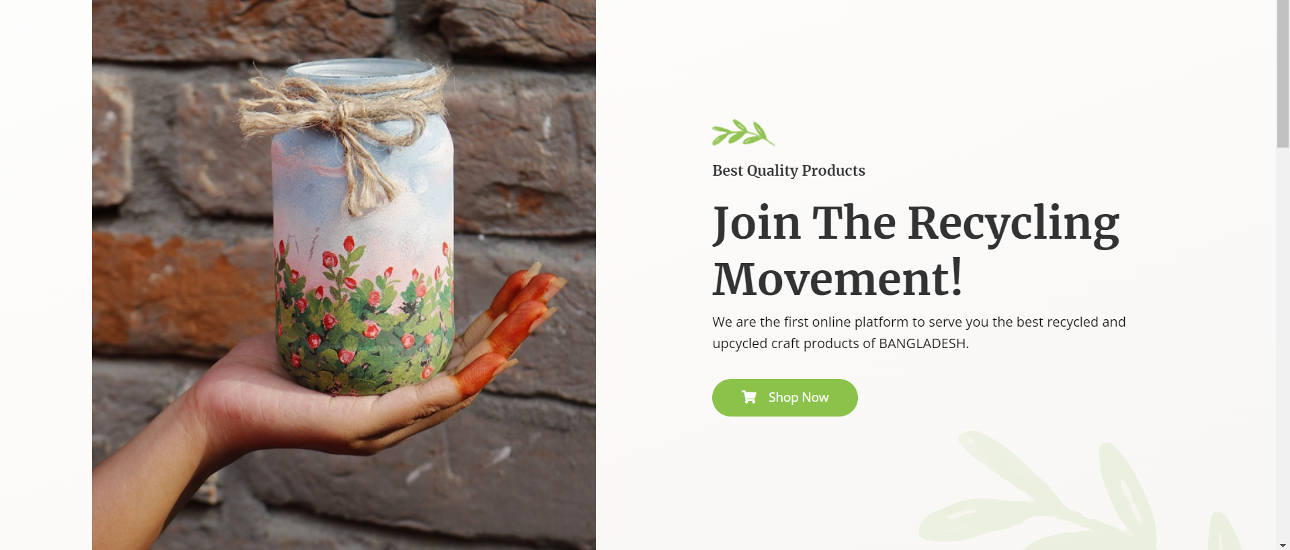

Slide 15
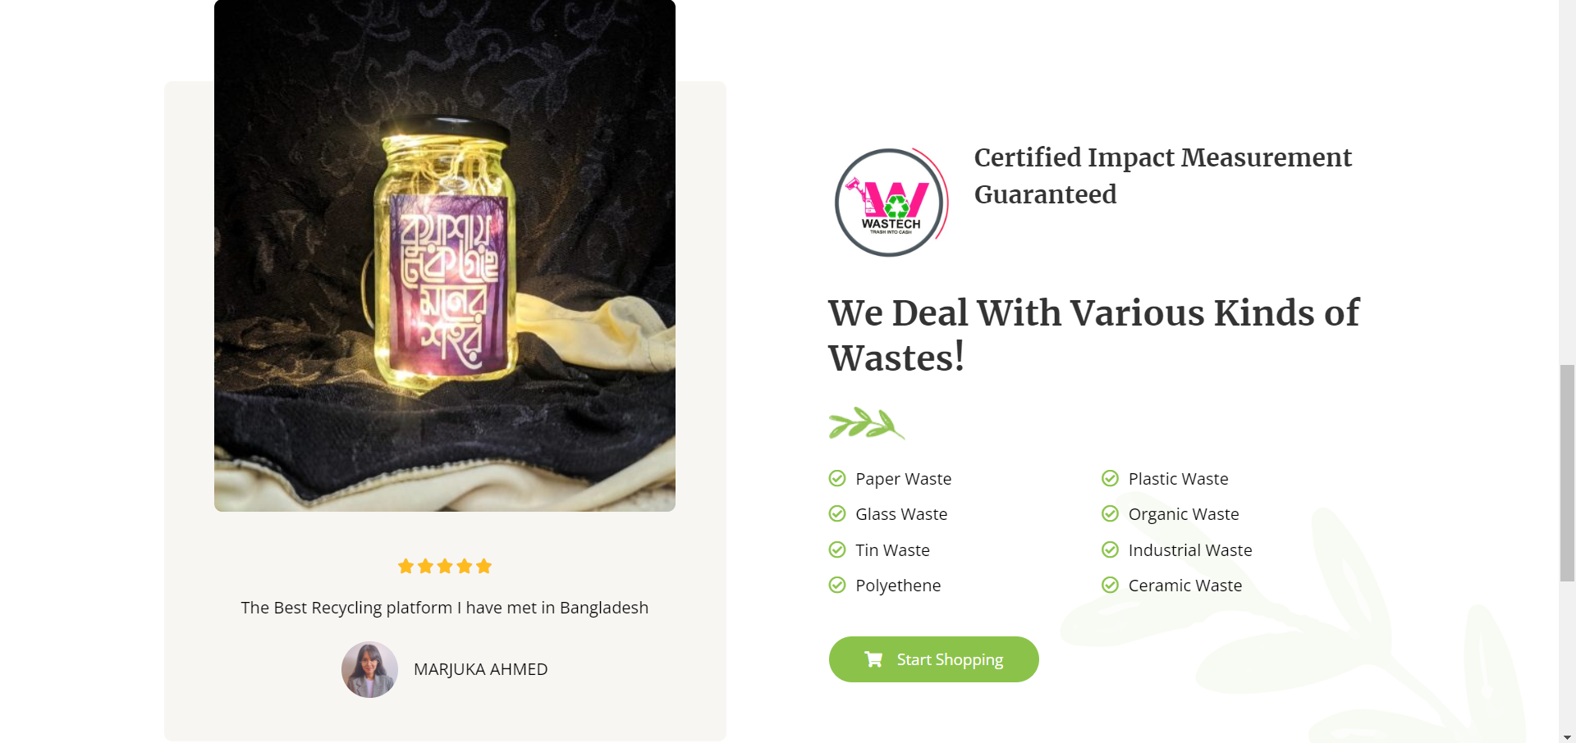

Slide 16
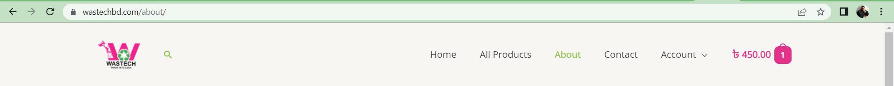
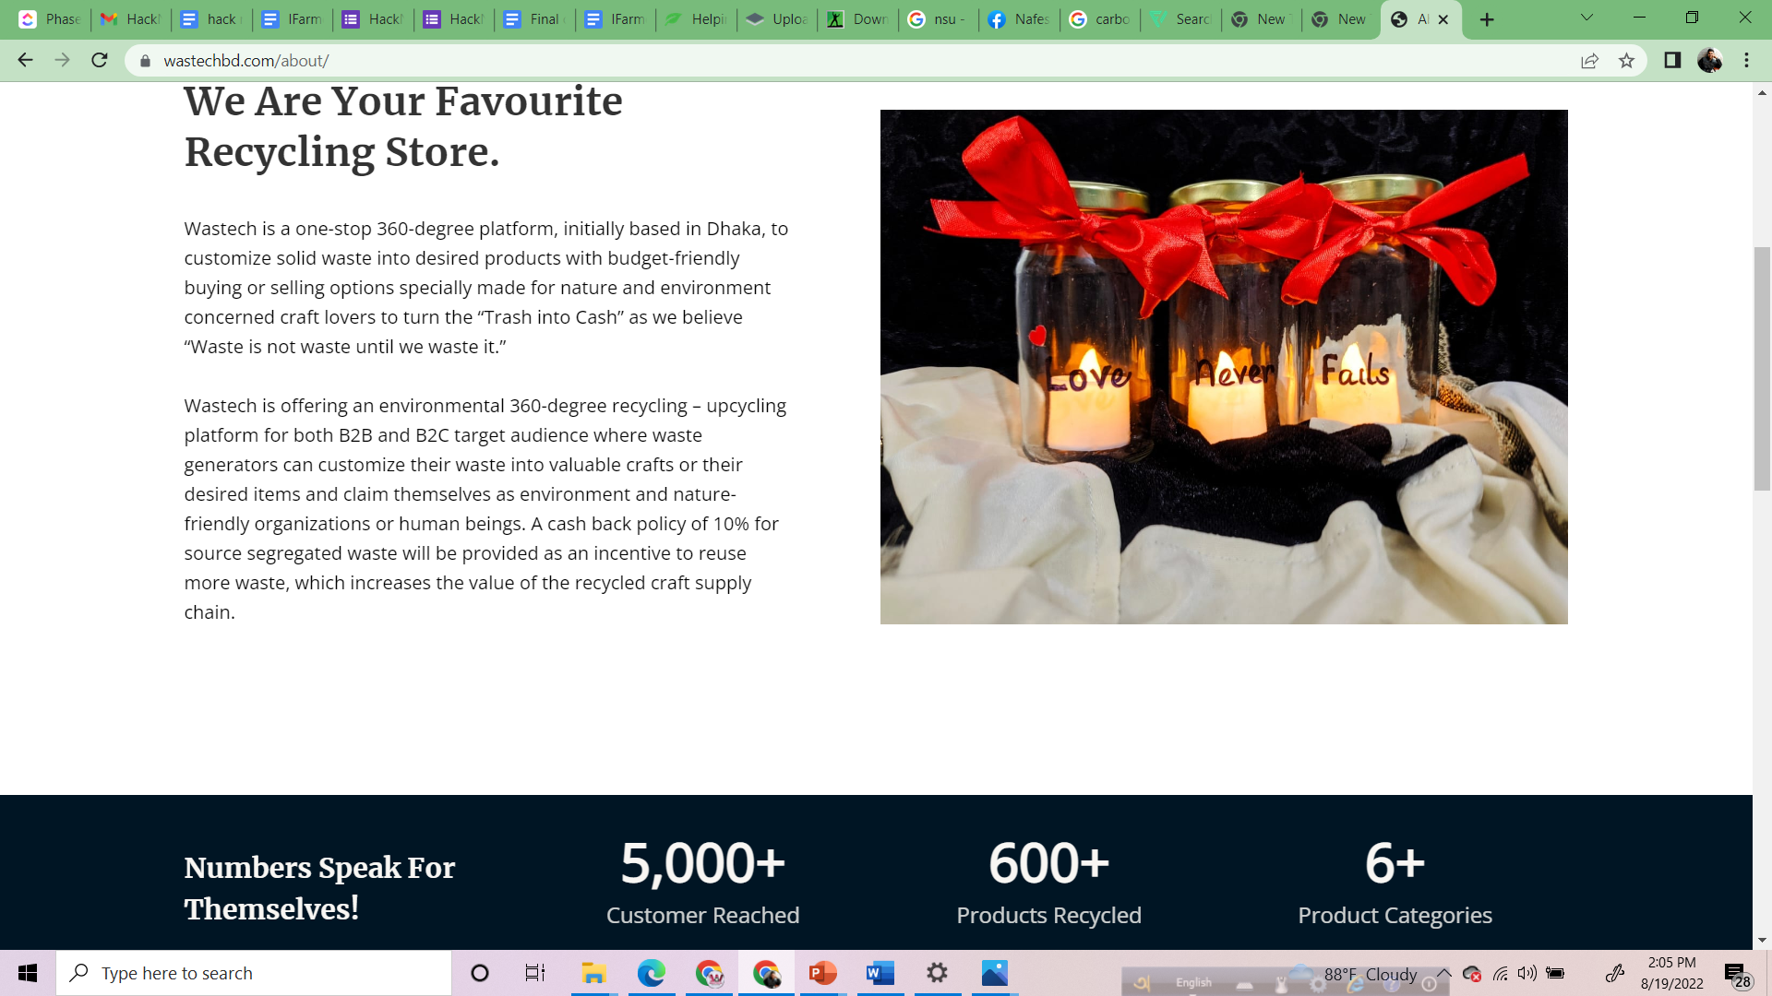

Slide 17
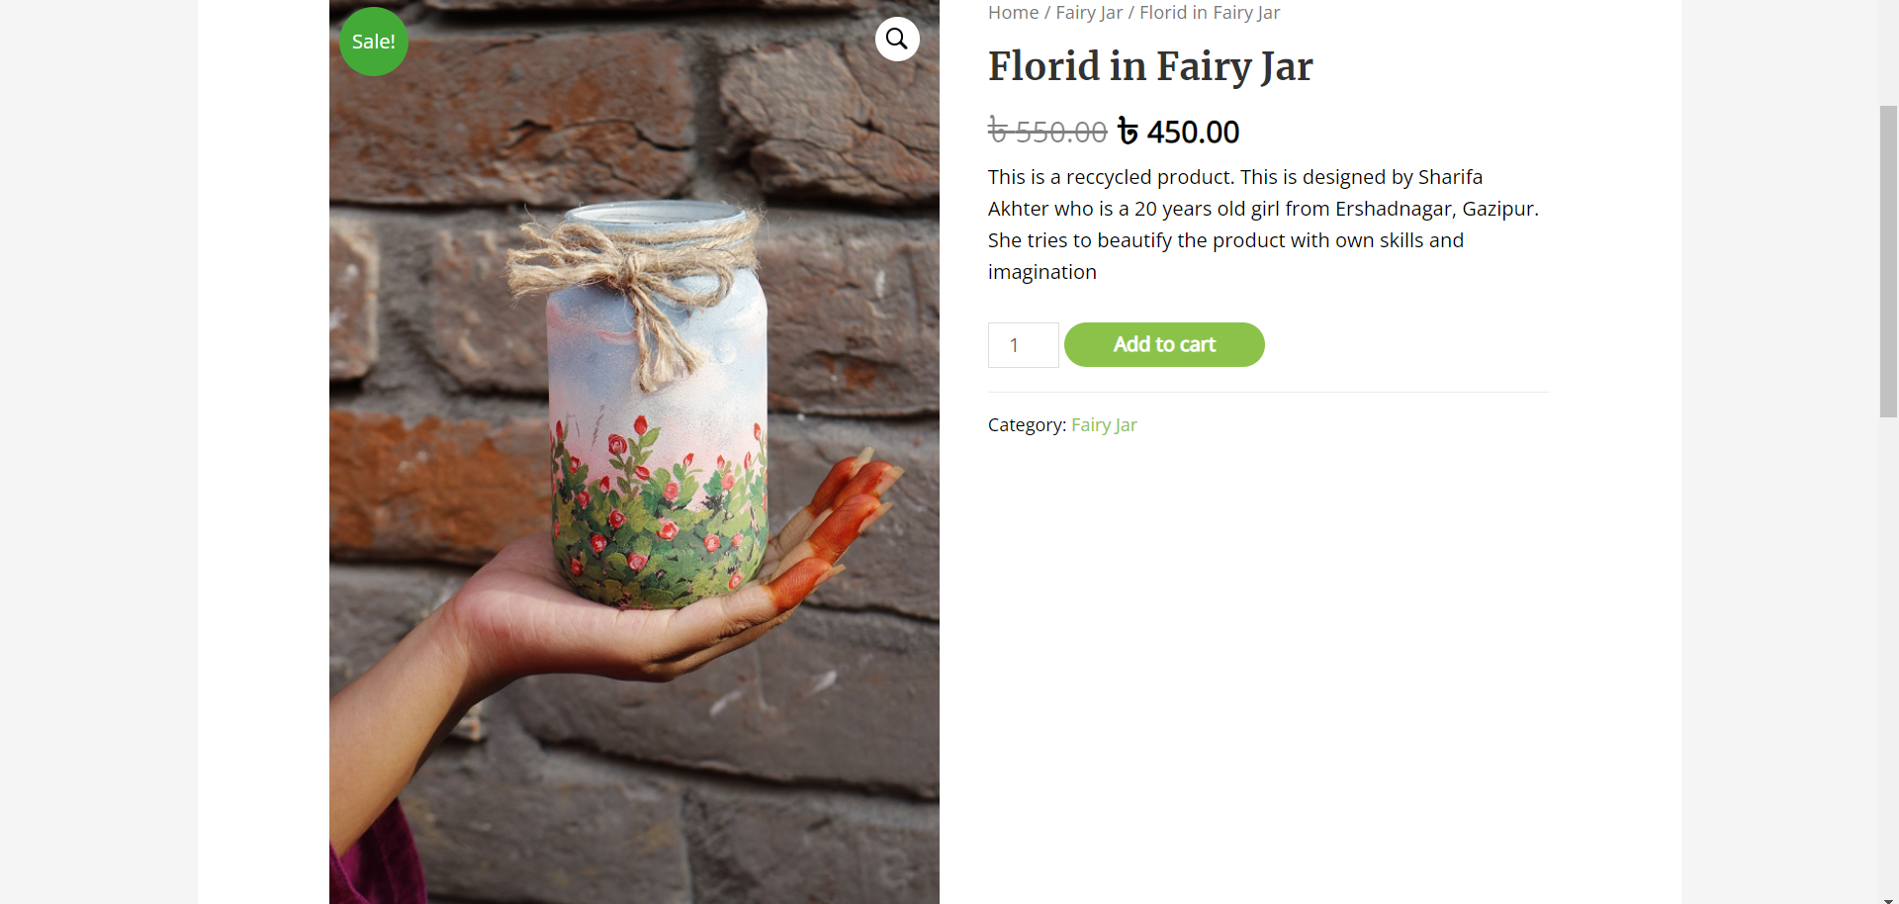
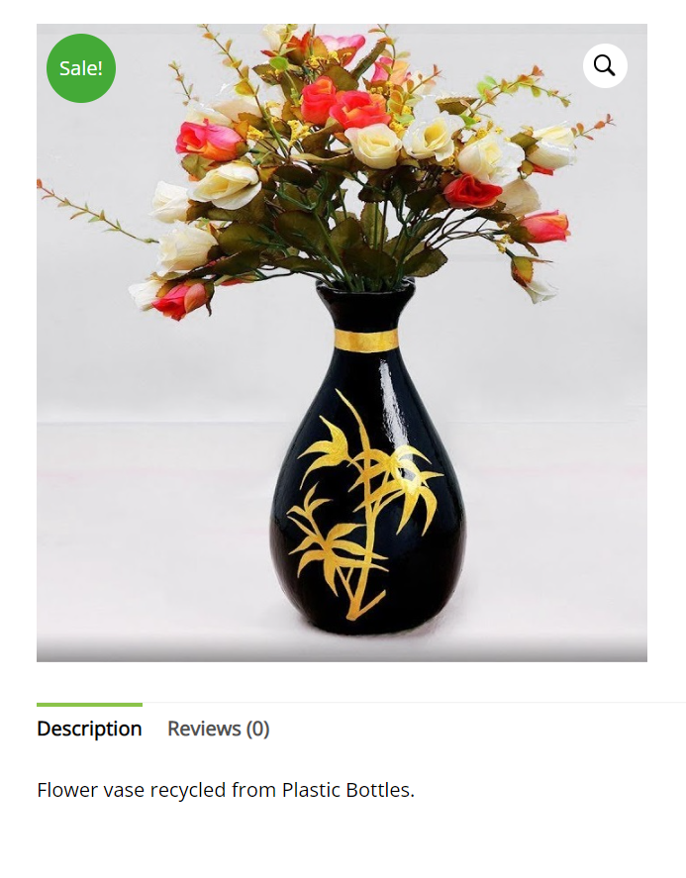

Slide 18
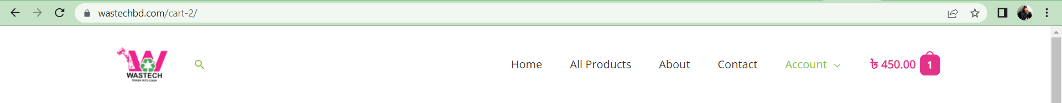
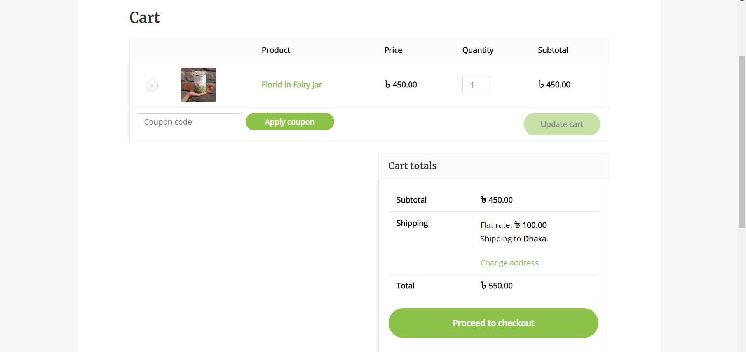

Slide 19
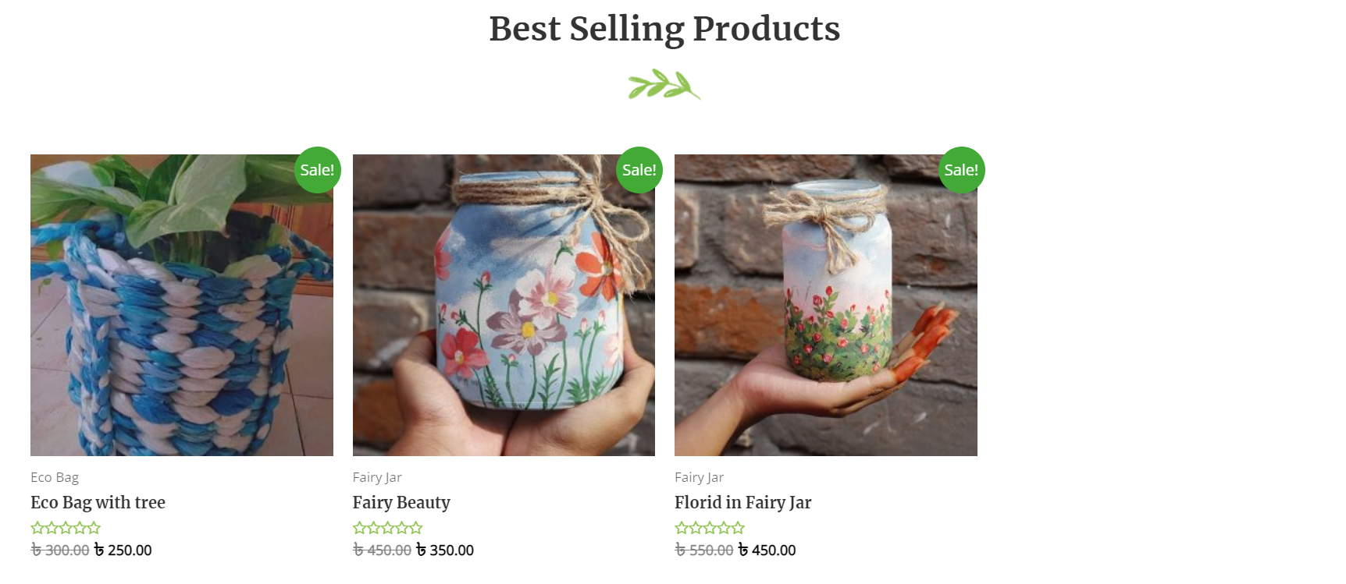
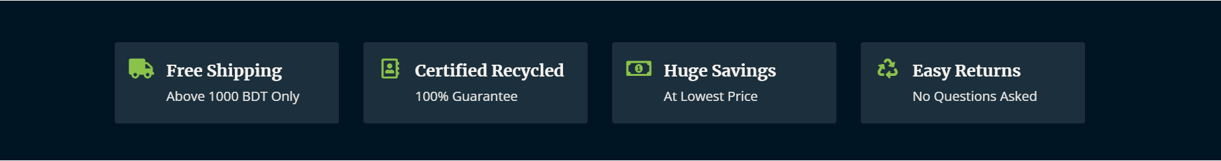

Slide 20







COMPETITOR ANALYSIS
WASTE CONCERN
AZIZU
GARBAGEMAN
DIGITAL VANGARIWALA
SEGREGATED COLLECTION FROM SOURCE
CUSTOMIZATION OPTION TO WASTE GENERATORS
IMPACT MEASUREMENT
ECO – FRIENDLY BADGE WITH DCC CERTIFICATION
CASHBACK INCENTIVE POLICY

Slide 21










IMPACT ANALYSIS
REDUCING 160 TONS OF WASTE
SAVES 70 SPECIES FROM EXTINCTION
60250 CUBIC FEET WATER
REDUCES 464 TONS OF CARBON EMISSION
IMPACT MEASUREMENT
INTEGRATED DATA, SURVEY, EXPERIMENTAL RESEARCH
WITH BLOCKCHAIN
WASTE PREVENTION RATE & CONSUMER REGULATION RATE

Slide 22
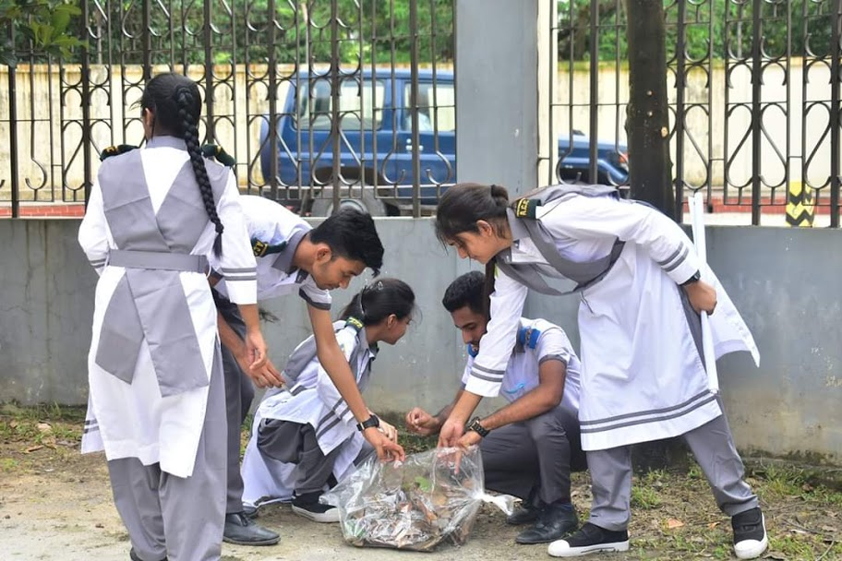
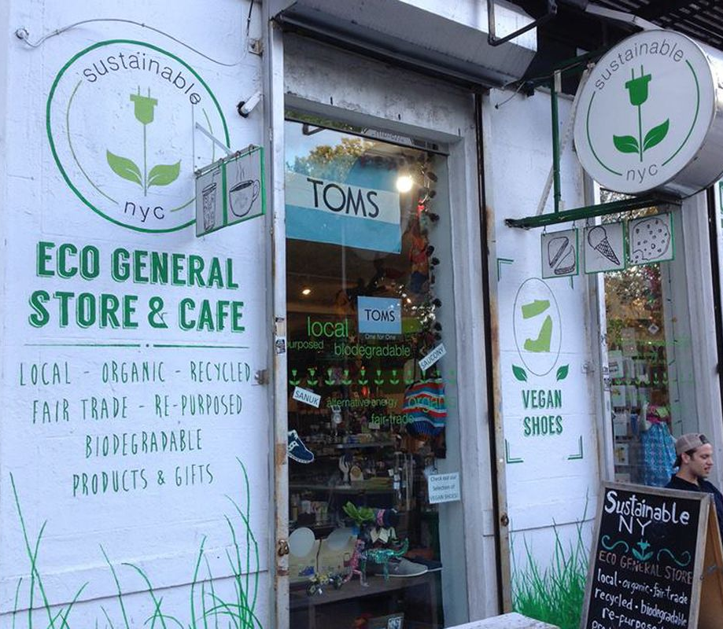
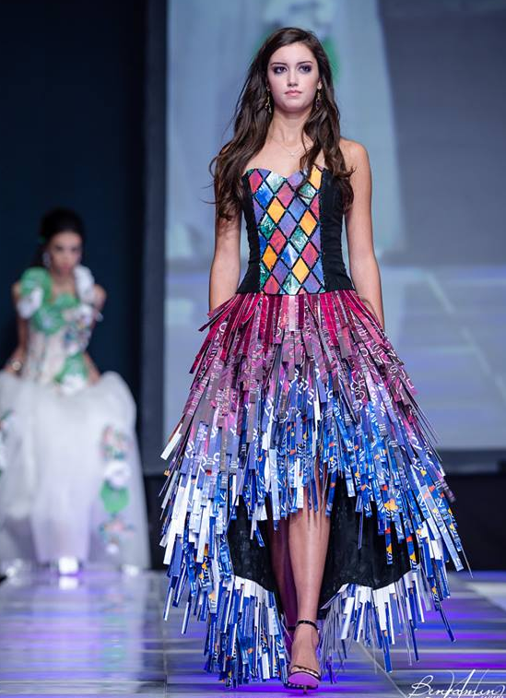




MARKETING
THROUGH
THE LINE
TTL
CPA
COST PER
ACTION
ECO CLUBS AND GREEN CAFES AS PROMOTIONAL PARTNER
SOCIAL MEDIA
MARKETING
SMM
CRAFTERS’ STORY,
OVC & SHORT FILM
ANIMATED CARTOON
INFLUENCER ENDORESEMENT
REVIEW GIVEAWAY
& CASHBACK GAMES
TRASHION
SHOW

Slide 23




REVENUE MODEL
GROSS MARGIN
NET MARGIN
PRODUCTION MODEL
134.28%
63.89%
PRICING 250% AVG
OF PRODUCTION COST
PRODUCTS | UNIT | COST/ UNIT | TOTAL COST | VALUE /UNIT | TOTAL VALUE | PROFIT (VALUE-COST)
DENIM WALLET | 200 | 100 | 20,000 | 250 | 50,000 | 30,000
GLASS CANDLE | 100 | 40 | 4,000 | 120 | 12,000 | 8,000
FAIRY LIGHT JAR | 400 | 200 | 80,000 | 500 | 2,00,000 | 1,20,000
FERTILIZER | 100 | 20 | 2,000 | 50 | 5,000 | 3,000
PEN HOLDER | 200 | 80 | 16,000 | 200 | 40,000 | 24,000
FLOWER VASE | 250 | 200 | 50,000 | 400 | 1,00,000 | 50,000
TOTAL | TOTAL | TOTAL | 1,72,000 |  | 4,07,000 | 2,35,000
E- COMMERCE MODEL
20% ON EACH
TRANSACTION
WASTE COLLECTION MODEL
DEMAND WISE PLAN
COLLECTION RATE 5TK/KG
CORPORATE PROJECT
PROJECT PROFITS
FOR CREATING IMPACT
APPROXIMATE GROSS PROFIT IN 1 MONTH = 2,35,000 BDT
ALL VALUES ARE IN BDT

Slide 24
EBITDA PROJECTION
INCOME STATEMENT | INCOME STATEMENT | INCOME STATEMENT | INCOME STATEMENT | INCOME STATEMENT | INCOME STATEMENT | INCOME STATEMENT
 |  | Year ended December 31, | Year ended December 31, | Year ended December 31, | Year ended December 31, | Year ended December 31,
all in BDT |  | 2022 | 2023 | 2024 | 2025 | 2026
REVENUE |  | 63,00,000 | 69,30,000 | 76,23,000 | 1,04,56,000 | 1,48,75,000
COGS |  | 33,43,000 | 35,11,590 | 36,30,604 | 47,36,000 | 68,84,000
GROSS PROFIT |  | 29,57,000 | 34,18,410 | 39,92,396 | 57,20,000 | 79,91,000
DEPRECIATION | + | 8,00,000 | 8,00,000 | 9,50,000 | 12,00,000 | 15,00,000
SG&A |  | 6,32,000 | 7,77,160 | 7,17,865 | 8,55,000 | 13,53,000
INTEREST | + | 1,20,000 | 1,20,000 | 1,20,000 | 1,50,000 | 1,50,000
EARNINGS BEFORE TAX |  | 14,05,000 | 17,21,250 | 22,04,531 | 35,15,000 | 49,88,000
TAX | + | 5,30,000 | 6,70,000 | 8,65,000 | 11,20,000 | 15,48,000
NET EARNINGS | + | 8,75,000 | 10,51,250 | 13,39,531 | 23,95,000 | 34,40,000
EBIDTA |  | 23,25,000 | 26,41,250 | 32,74,531 | 48,65,000 | 66,38,000

Slide 25
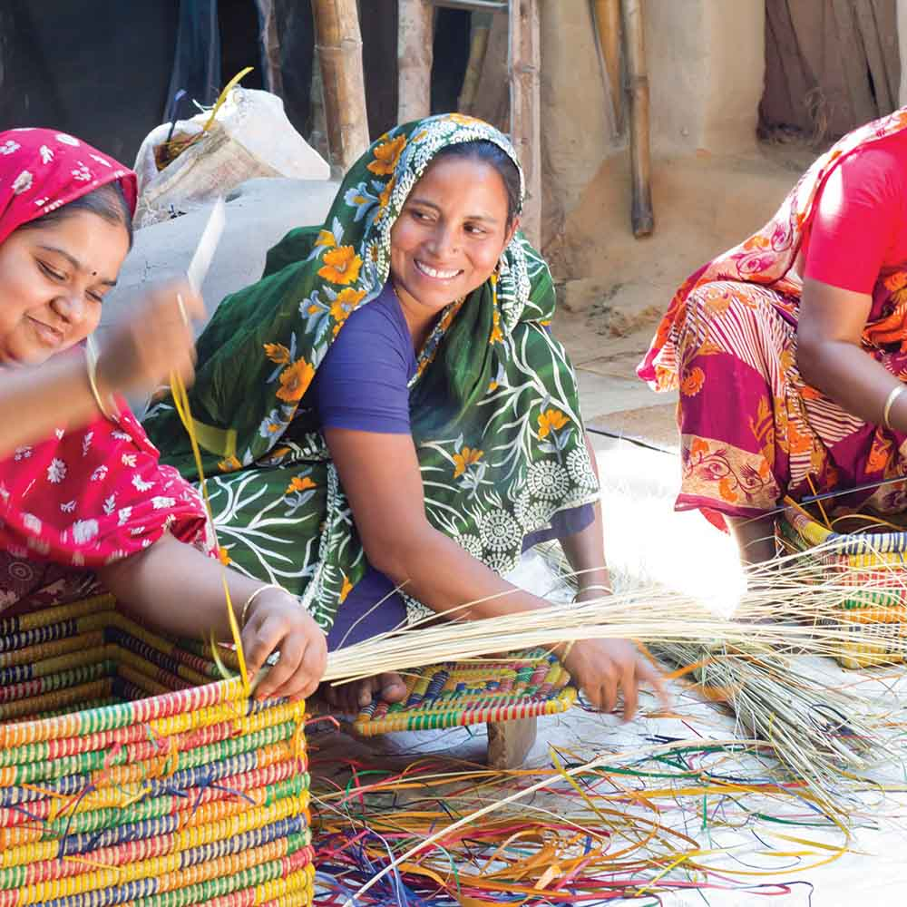
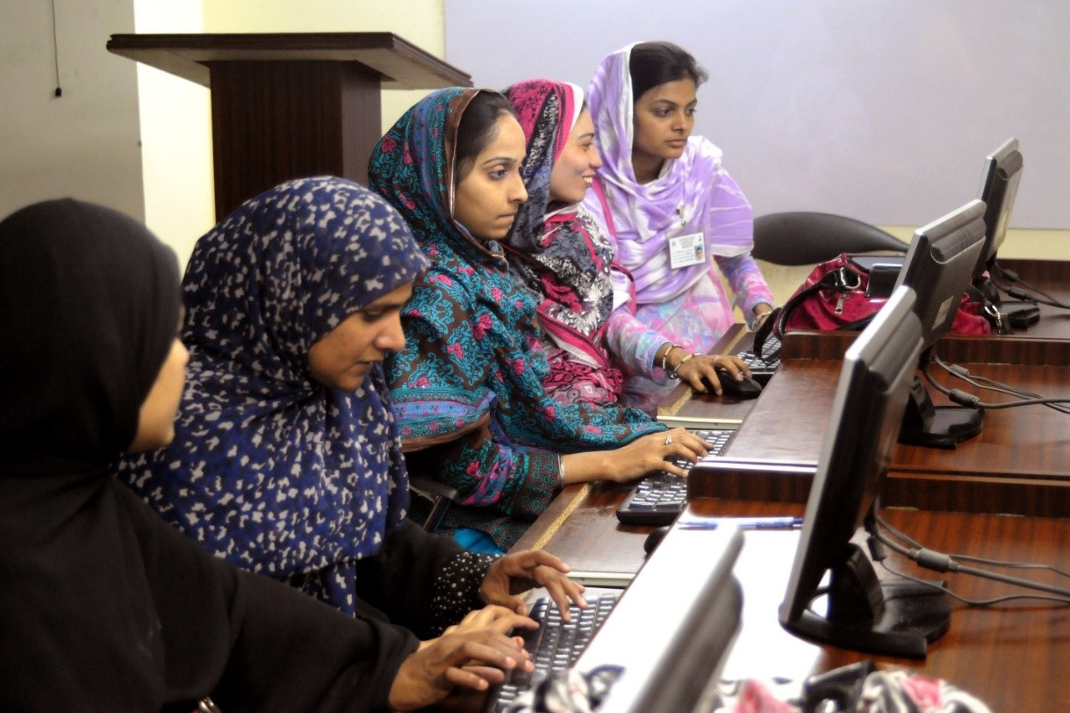

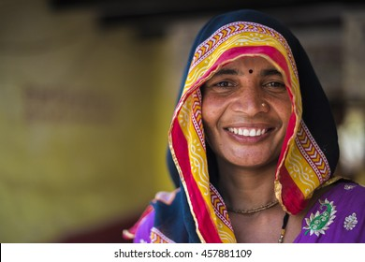
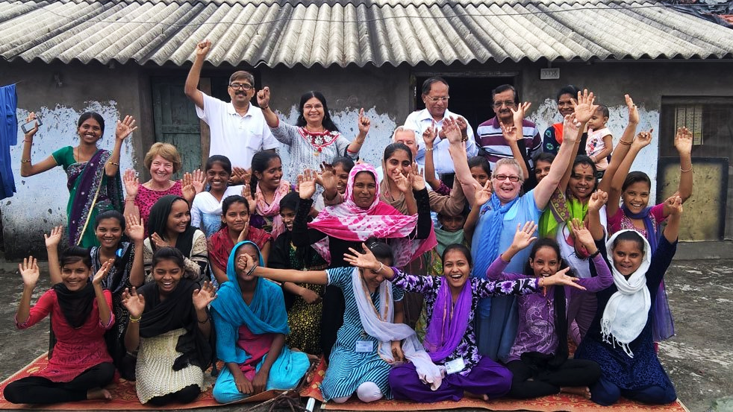
EMPOWERING WOMEN

Slide 26
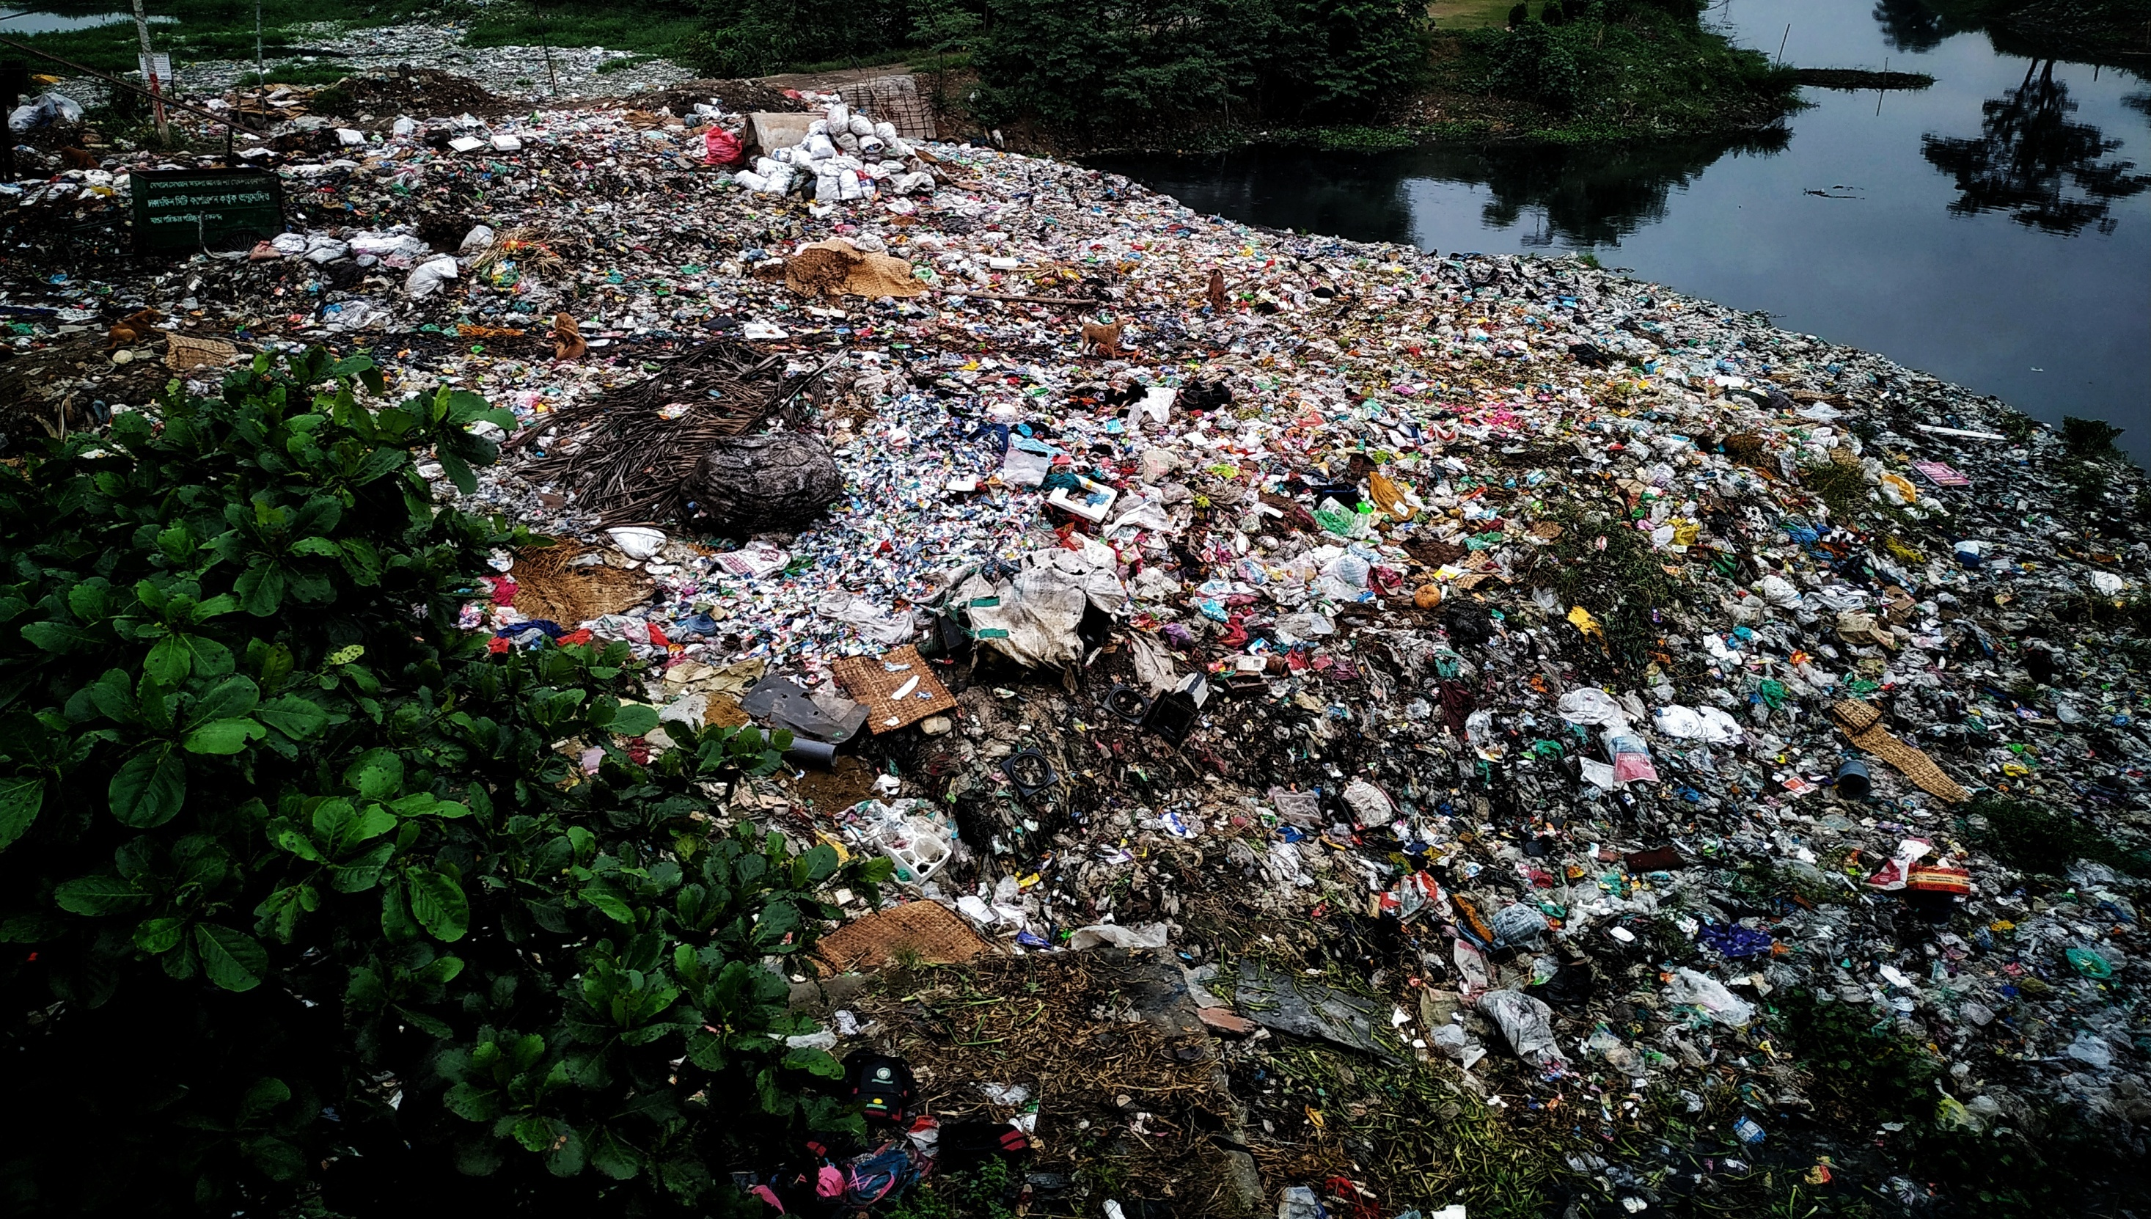


WASTE IS
NOT WASTE
UNTIL
WE
WASTE
IT

